Slide 1
Nik Molnar  nikmd23
WHOPPER.Js

Slide 2

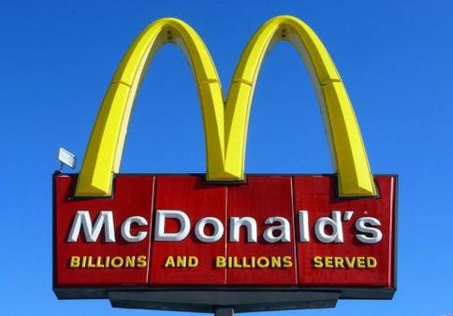
Npm:
508,474
GitHub:
1,604,219
Notes:
http://www.modulecounts.com/
McDonalds billions and billions sold: https://www.youtube.com/watch?v=KzOSkO8BZFw

Slide 3
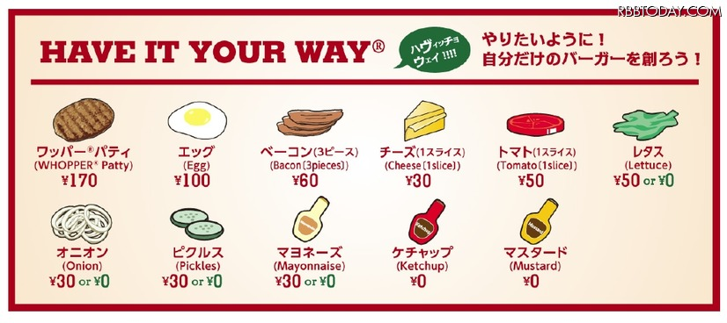

Slide 4
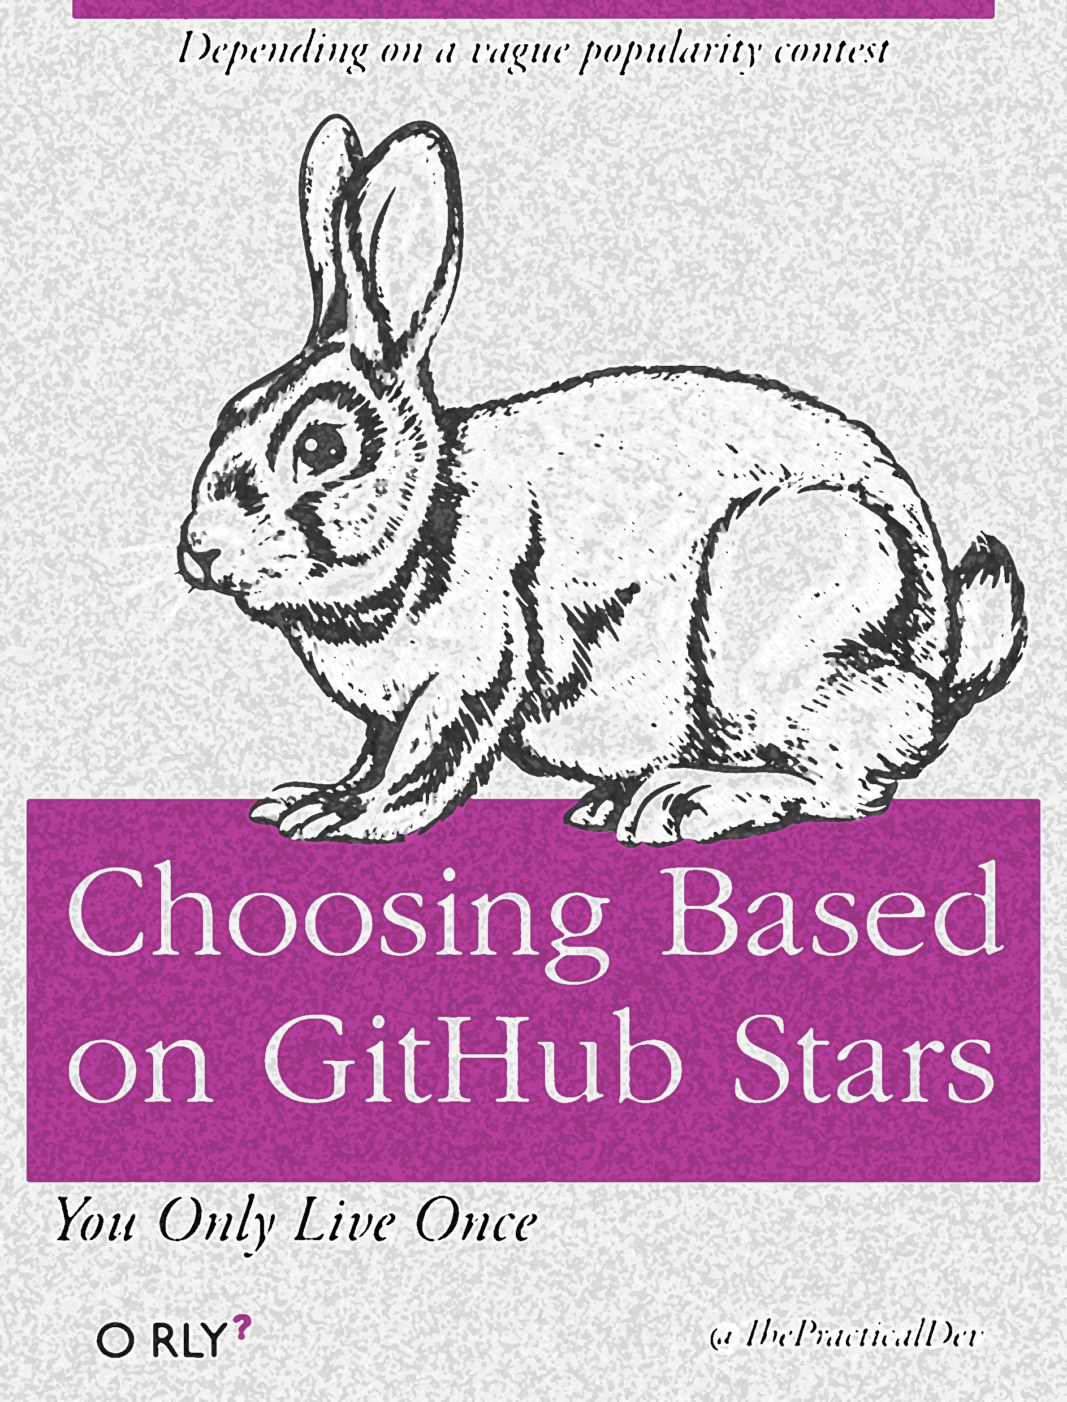



Slide 5
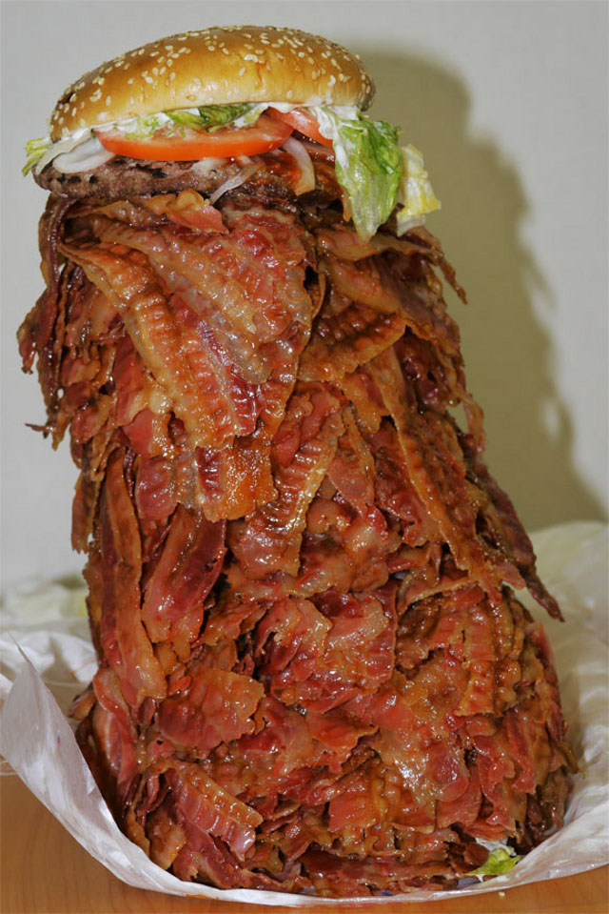
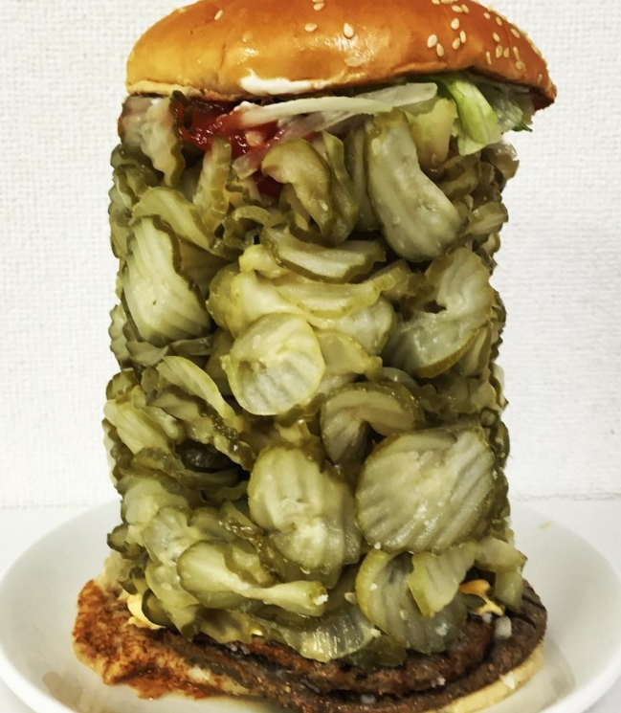
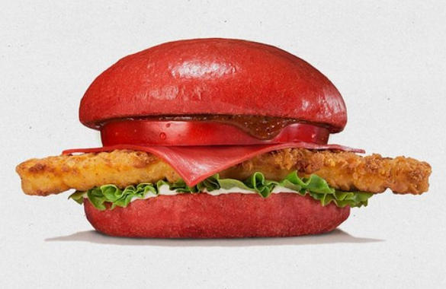
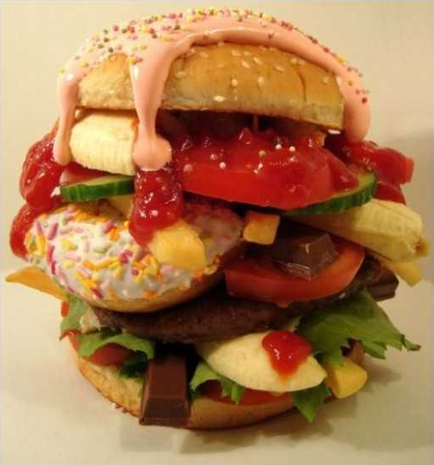
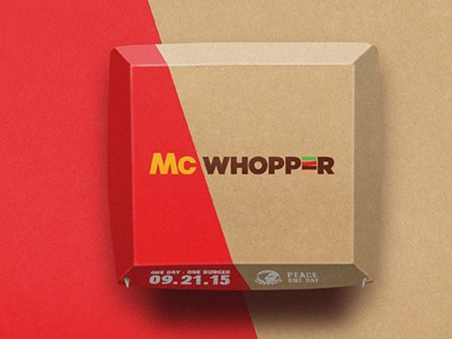
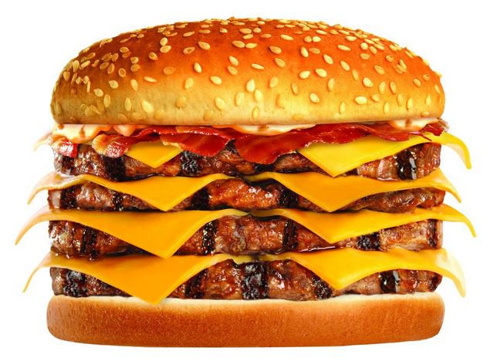

Slide 6

Hadouken

Slide 7

Serverless

Slide 8
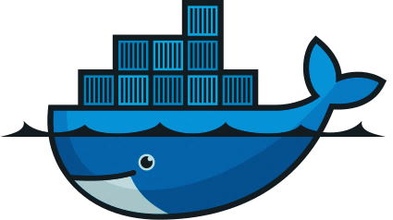
docker

Slide 9
OUTLINE
JS is everywhere and awesome
You should be able to have it, and have it your way
The ecosystem provides a lot of options
Jokes about noun.js
Interoperability is important in case you choose the wrong thing, or you project changes
That means you might make something weird
Crazy burger creations
That’s the beauty of it
Interoperability
Hosting like Cattle Farmer, Home Cook, Burger King for On-Prem, IaaS, PaaS
Docker is an example of this
Functions as a Service is another

Slide 10
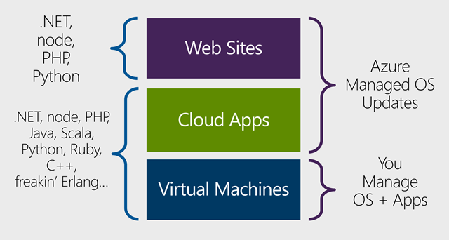
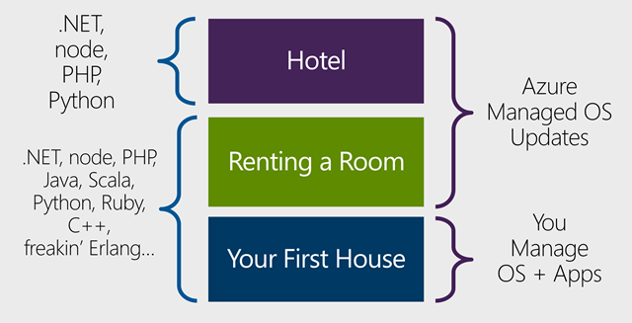
Notes:
https://www.hanselman.com/blog/IntroducingWindowsAzureWebJobs.aspx

Slide 11
